Slide 1

Data processing terminal
Make in India

Slide 2
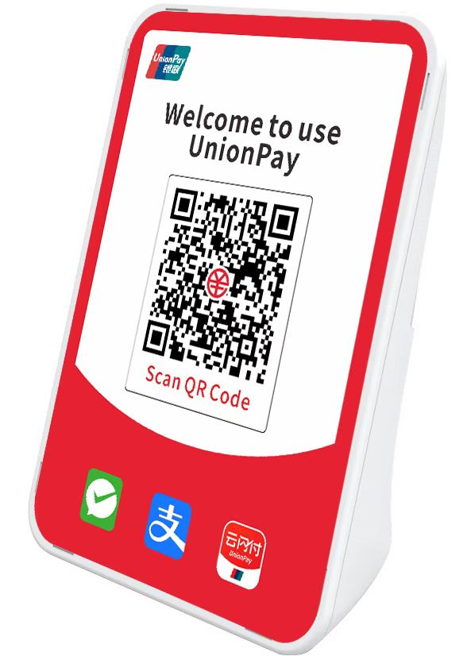

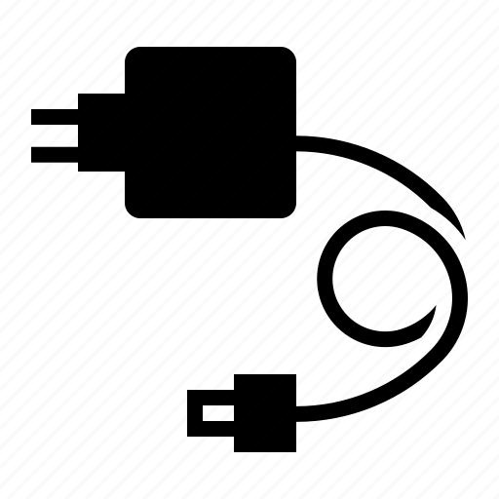




Payment Notification Sound box
3w speaker
input: 100~240V AC 50~60Hz Output: 5V/1A
PWR button, Vol+/- button, Function button
1500 mAH / 2000 mAH/ 2600mAH
1 slot –Micro SIM
Micro USB for charging
Option - 2G only
Option - 4G only
Option – 2G+4G
Option - 2G + Wi-Fi
Option - 4G+ Wi-Fi
Option- 4G+2G+Wifi
Option – 4G+2G+ BT

Slide 3
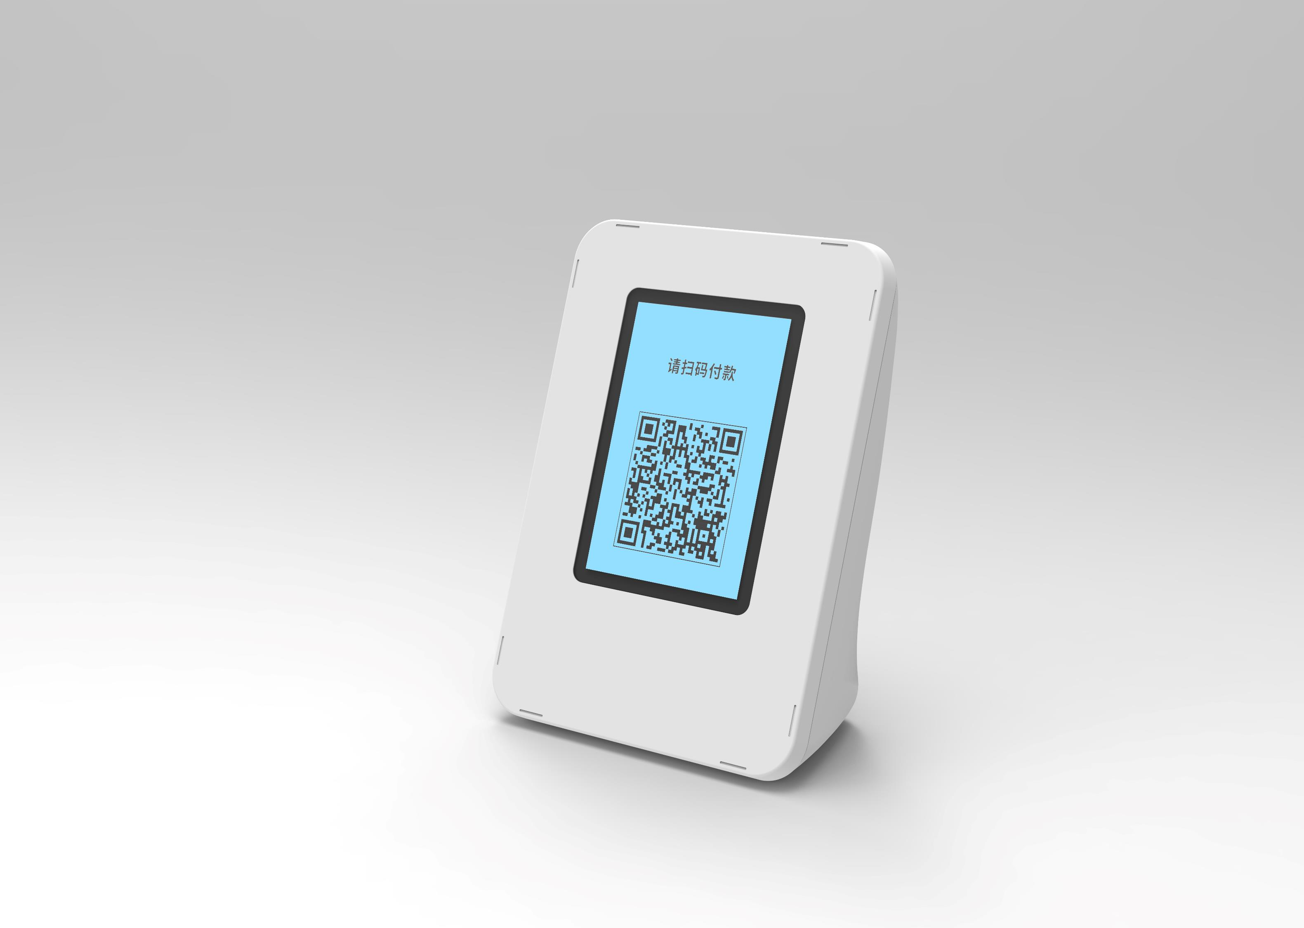
Payment Notification Sound box with Dynamic QR display
Display size – 2.4-inch
2G only
Option - 4G only
Option - 2G + Wi-Fi
Option - 4G+ Wi-Fi
 | 3w speaker
 | input: 100~240V AC 50~60Hz Output: 5V/1A
 | PWR button, Vol+/- button, Function button
 | 1500 mAH / option 2000 mAH
 | 1 slot –Micro SIM Micro USB for charging

Slide 4
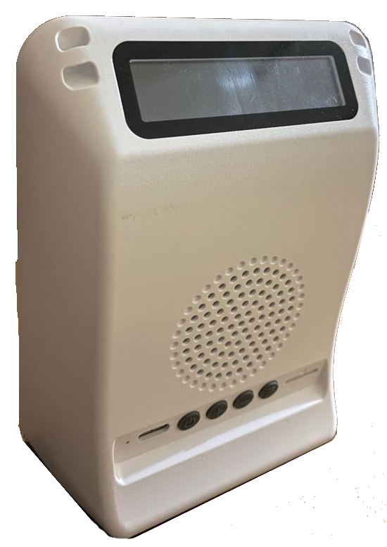
Payment Notification Sound box with 7 segment LED display
3w speaker
7 segment LED Display for Amount
Network status
Batter status
input: 100~240V AC 50~60Hz Output: 5V/1A
PWR button, Vol+/- button, Function button
1500 mAH / 2000 mAH/ 2600mAH
1 slot –Micro SIM
Micro USB for charging
Option - 2G only
Option - 4G only
Option – 2G+4G
Option - 2G + Wi-Fi
Option - 4G+ Wi-Fi
Option- 4G+2G+Wifi
Option – 4G+2G+ BT

Slide 5
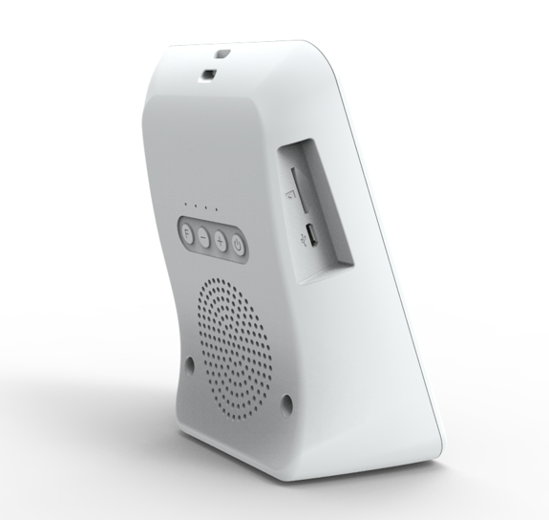
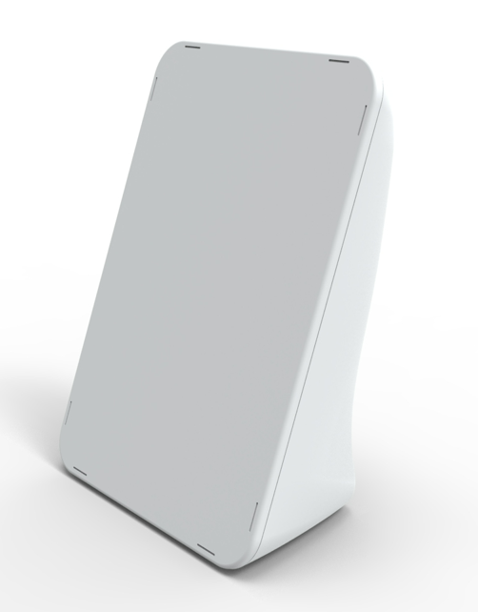
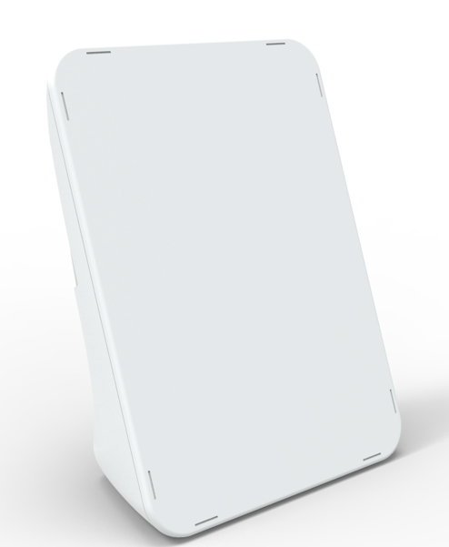
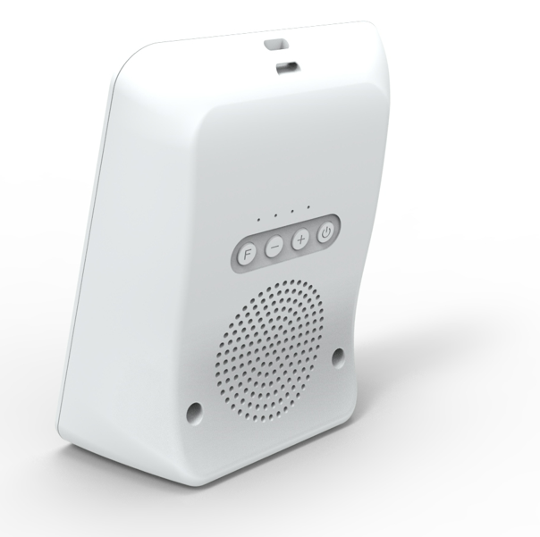

Slide 6
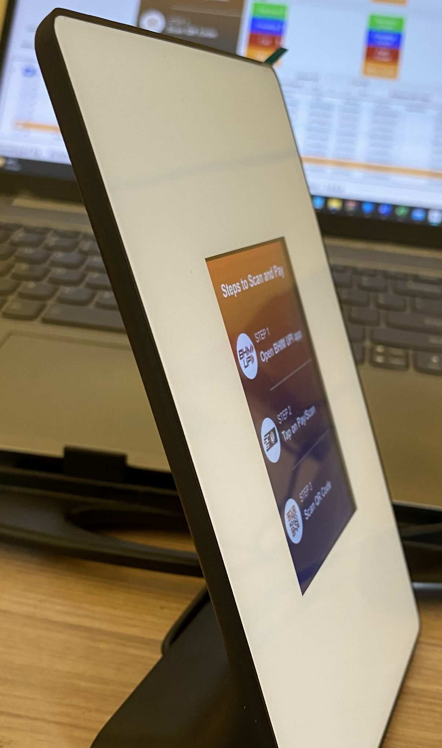
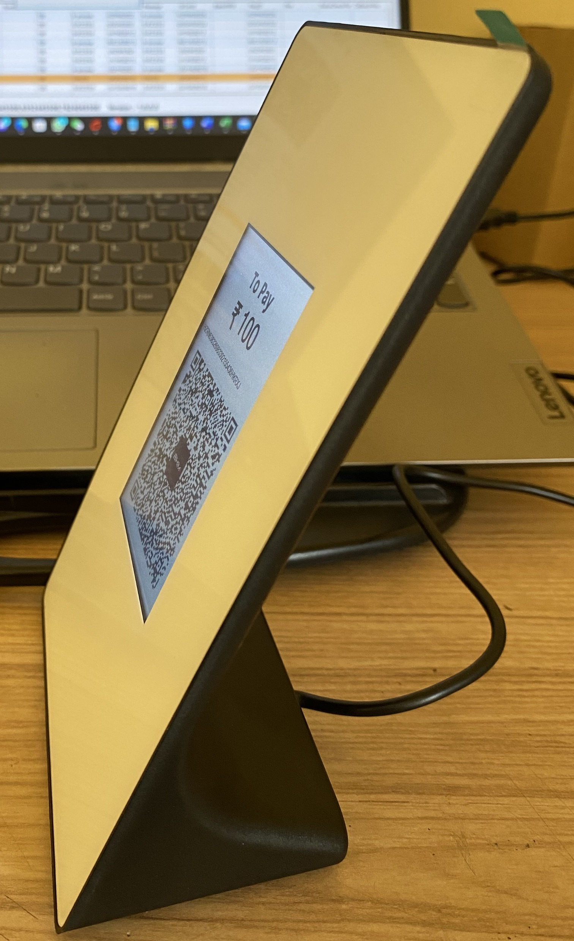
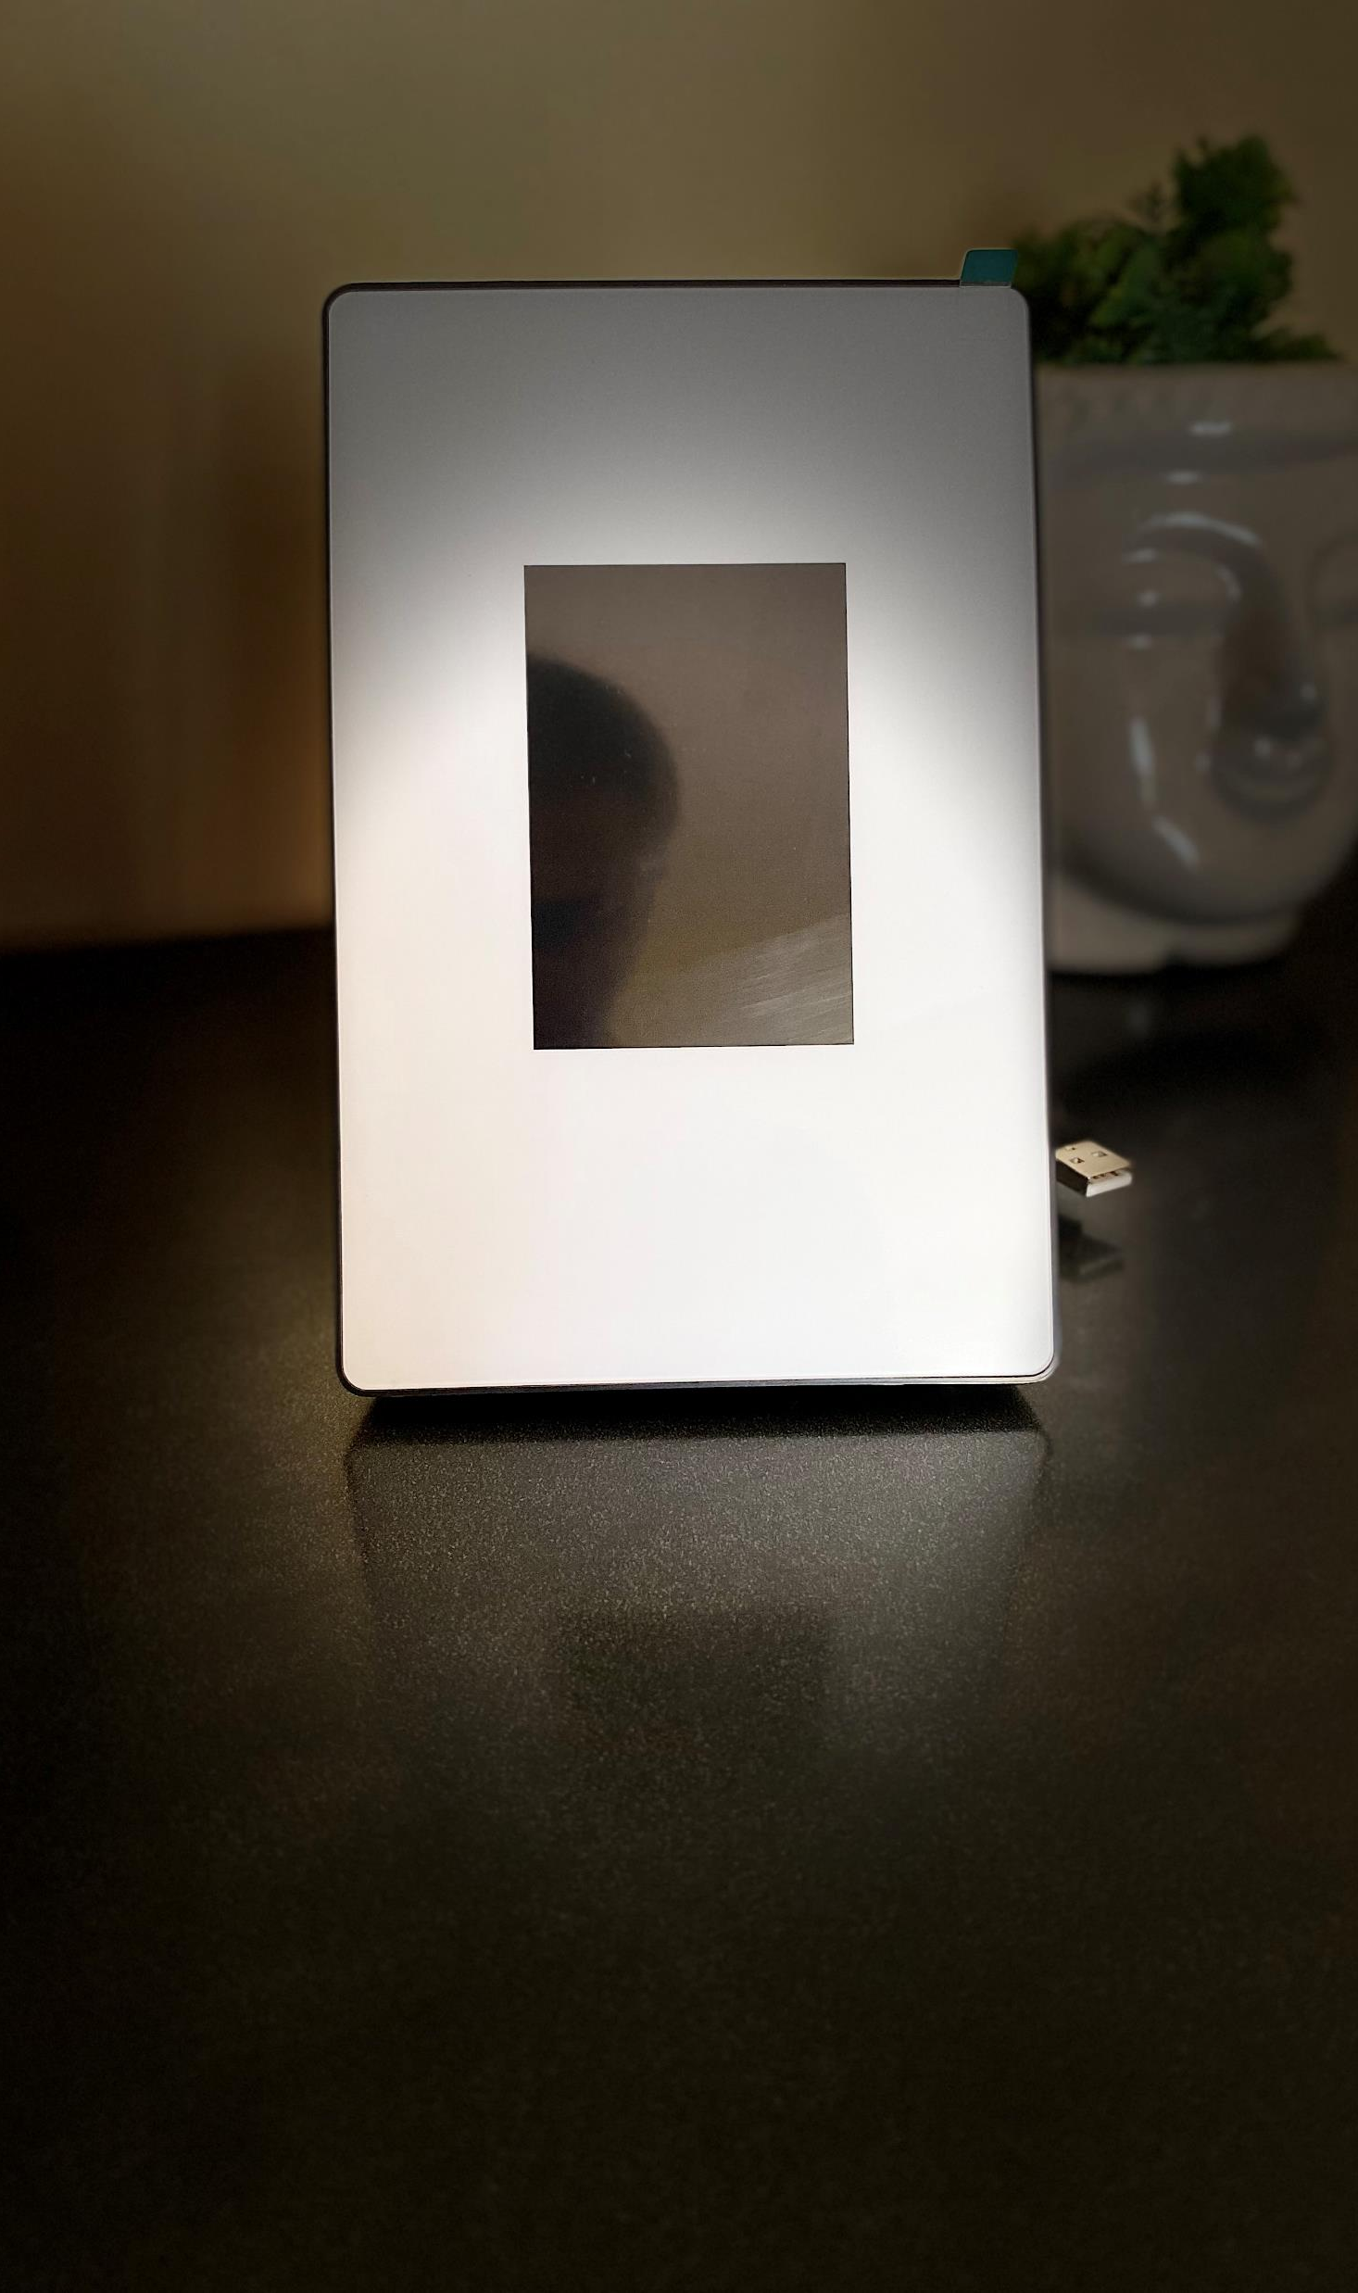
Most Suitable product to Accept payment through UPI Billing system/POS
Processor 32-bitsARM
Display 3.5”TFTLCD, 320*480 pixels
USB Cable 1.2m，TypeAUSBplug
Communication USB CDC Serial port
Weight 170g±10g

Slide 7
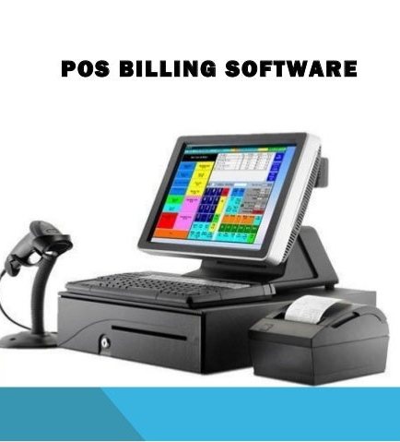
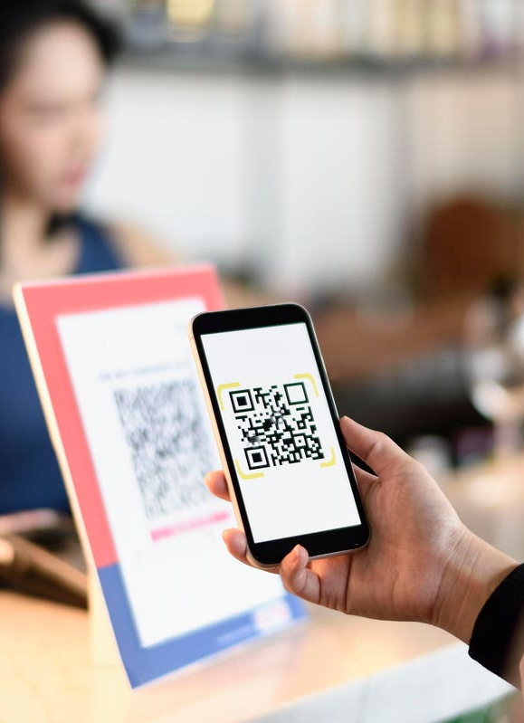
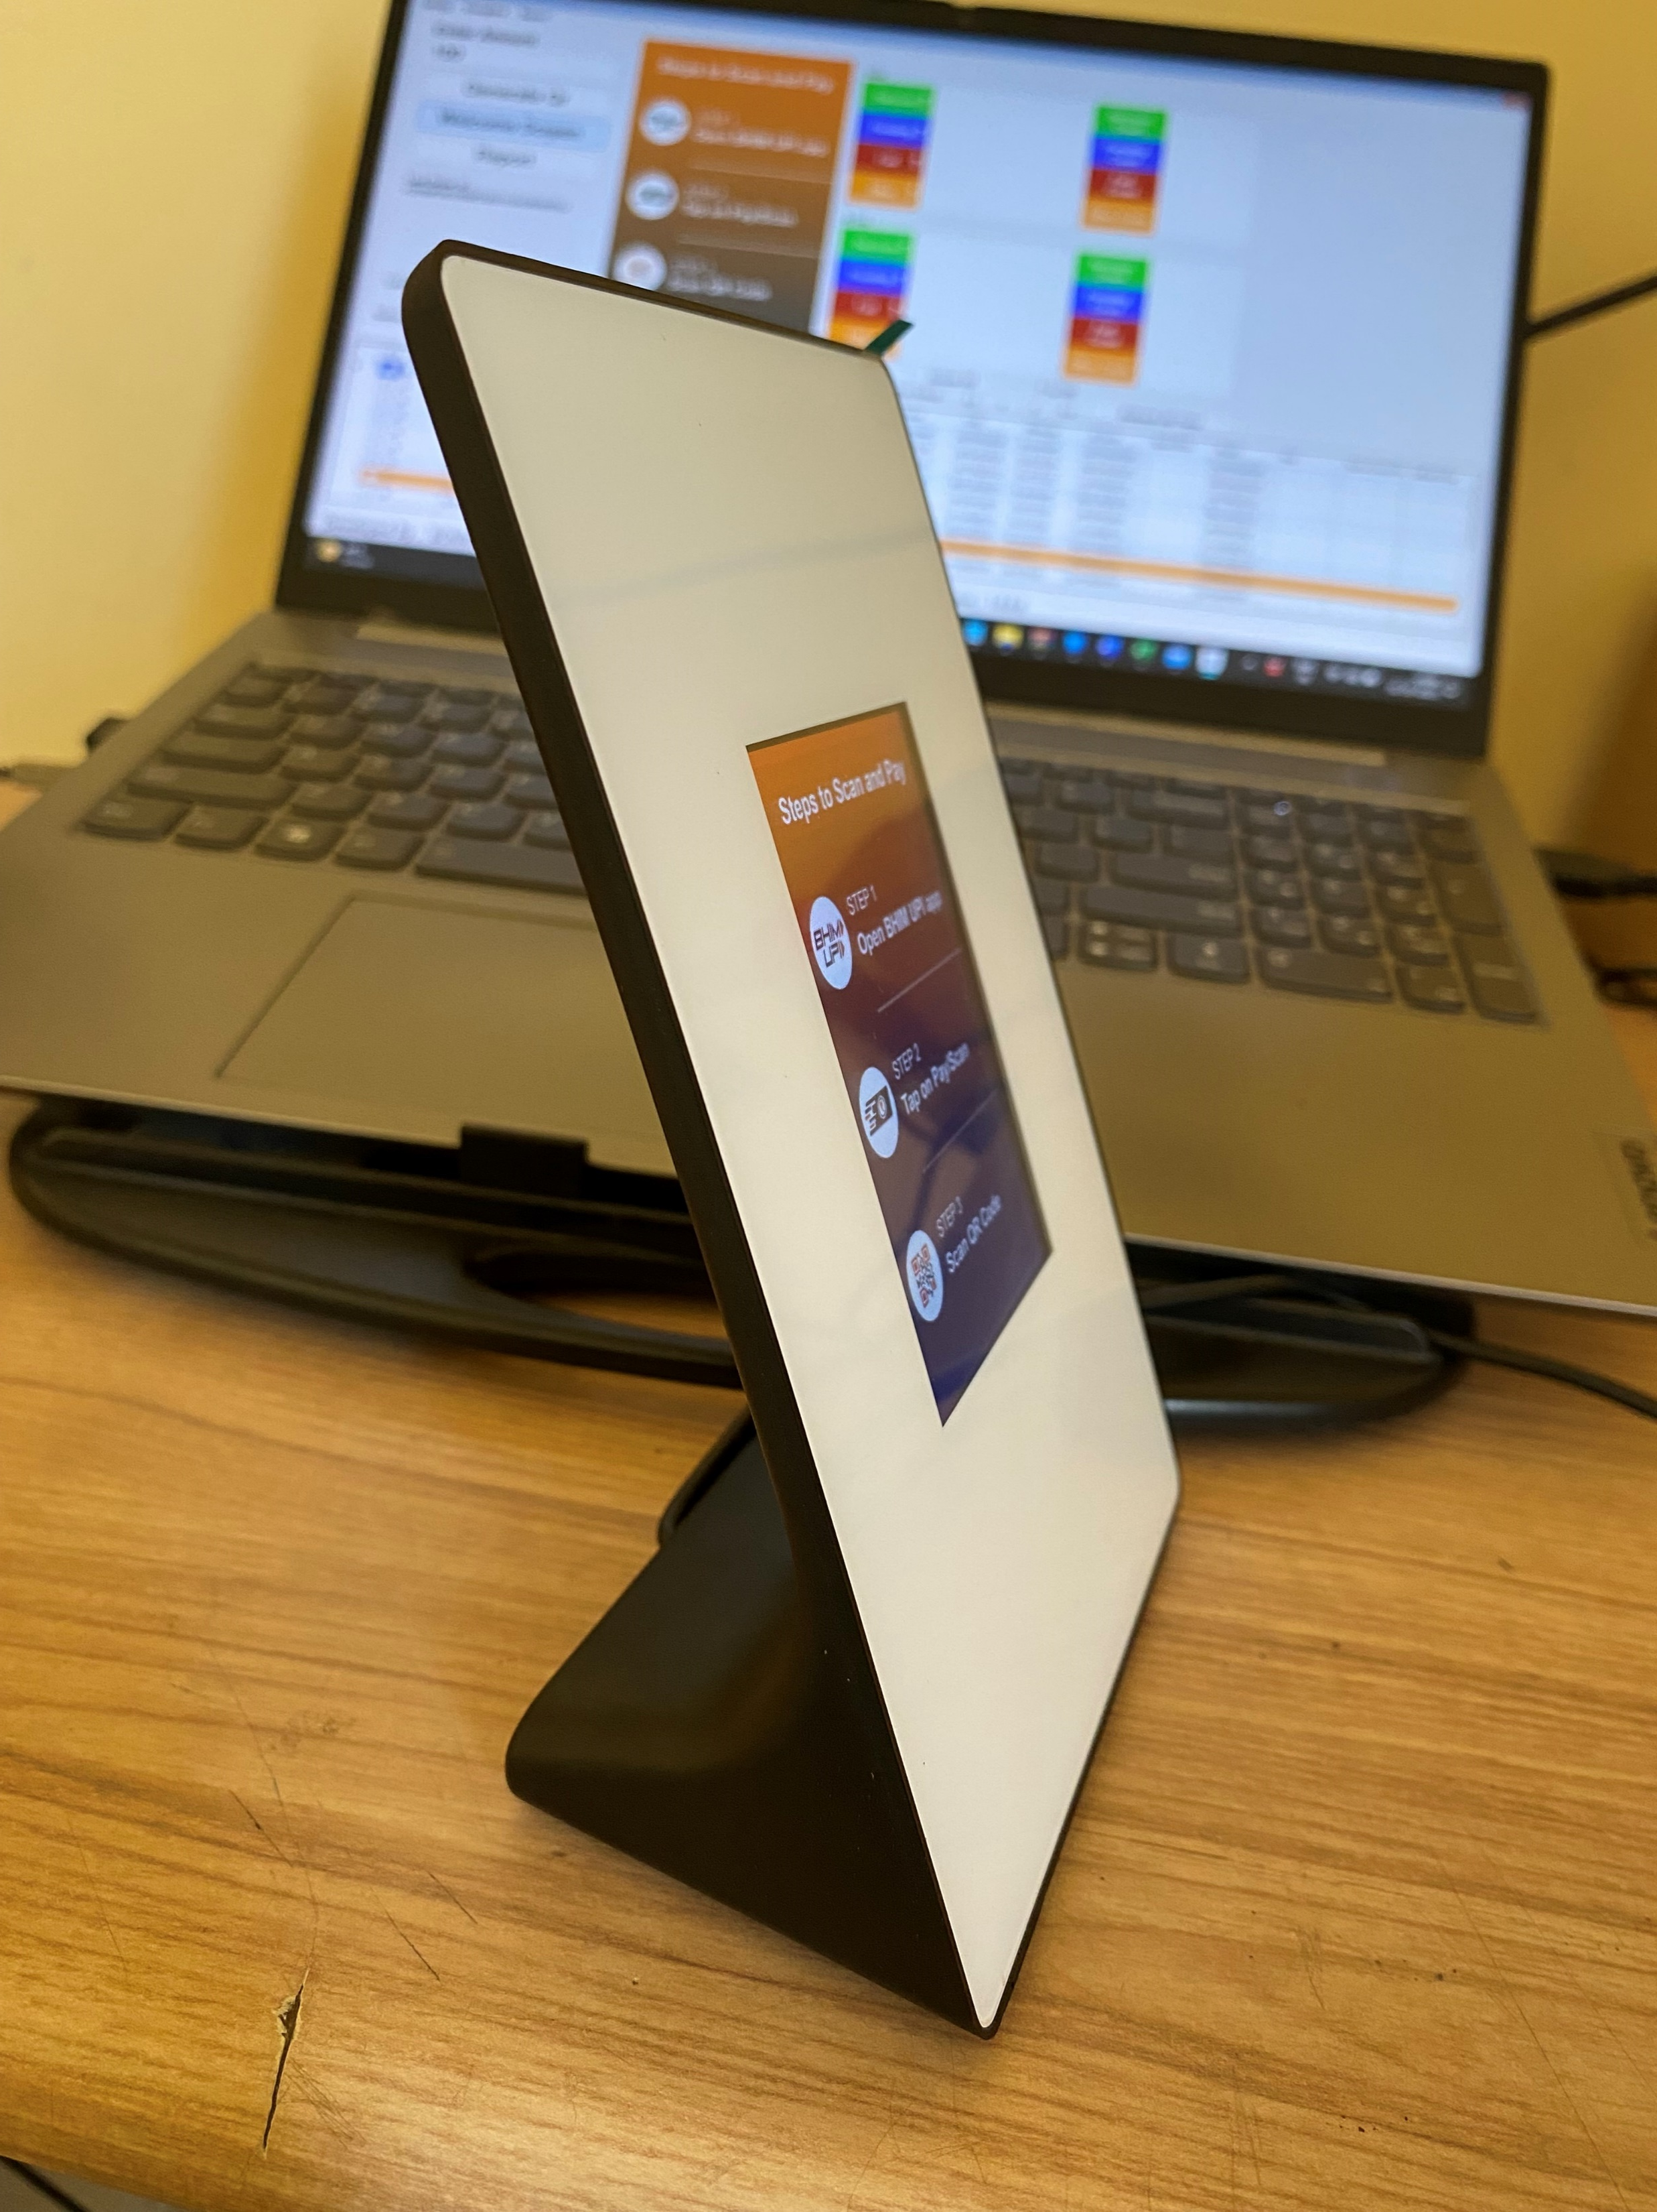
Benefit
Customer scan and make
Payment
QR image send to DQR
Payment status display
on screen
POS/Billing software Generate QR code
Merchant control the amount
Customer don’t need to enter amount
Each QR code generated by a merchant for an order is unique.
UPI Settlement can match with Billing system order and amount
Accept payment by any UPI app and have status report at same time
Configure any UPI code & easy to change

Slide 8
Integration support
Software customization support
Client application development support
Device integration support on running server/Solution.
Provide FOTA support.
Multi language support.
Device firmware/ certificate/keys/ credentials are encrypted, can’t access without proper key for security.
Certification
Hardware Certificate – BIS/ RoHS

