Slide 1


Bonrix Software Systems: AI-Powered Solutions for the Future
Where Ideas Map to Reality

Slide 2





Company Overview
Founded in 2001 with a vision to transform IT solutions
Based in Ahmedabad, Gujarat, India
Mission: Profitable growth through providing better than best IT Solutions and superior customer service, innovation, quality and commitment
Core focus areas: AI/ML solutions, Telecom Recharge Software, Bulk SMS Solutions, and more

Slide 3
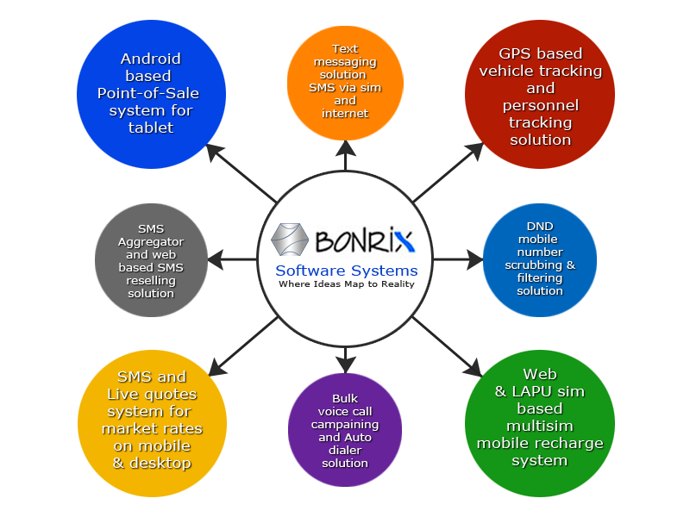







Core Business Areas
AI/ML Solutions
Telecom Recharge Software
B2C Web & Android Apps
GST Solutions
Voice Auto Dialing Solutions
Bulk SMS Solutions
Restaurant Management Solutions

Slide 4

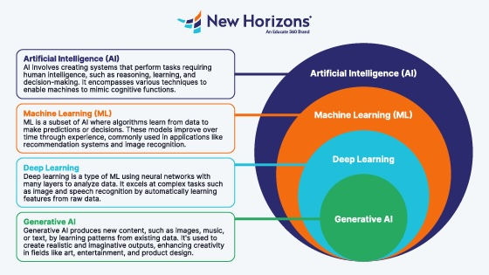


AI/ML Capabilities
Deep Learning
Neural networks that process data with human-like intuition
Continuous Learning
Systems that evolve with user needs through reinforcement learning
Privacy-Focused AI
Federated learning models that ensure data privacy

Slide 5









AI/ML Products
Face Recognition
Object Detection
For secure authentication in various systems
For retail shelf monitoring and inventory management
Intelligent Chat Bot
Video Surveillance
For customer support and engagement
For public safety monitoring
CCTV Footage Analysis
Parking Slot Availability
For post-incident investigation
For smart parking management
Industrial Machine Monitoring
Robotic Automation
For manufacturing assembly lines
For predictive maintenance

Slide 6





Benefits of Bonrix's AI Solutions
Automate Complex Processes
Cut costs and boost efficiency
Predict Trends & Behaviors
Make data-driven decisions with confidence
Solve Industry-Specific Problems
From logistics to healthcare, deliver real-life results
Seamlessly Integrate AI
Enhance existing workflows without disruption

Slide 7



Contact Us
Address
A-801, Samudra Complex Near Classik Gold Hotel Off C.G.Road, Ahmedabad Gujarat - 380009, India
Phone
+91-9426045500 +91-9429045500 +91-7624045500
Email
info@bonrix.net bonrix@gmail.com
Where Ideas Map to Reality

