Slide 1

Bonrix Software Systems
Where Ideas Map To Reality

Slide 2

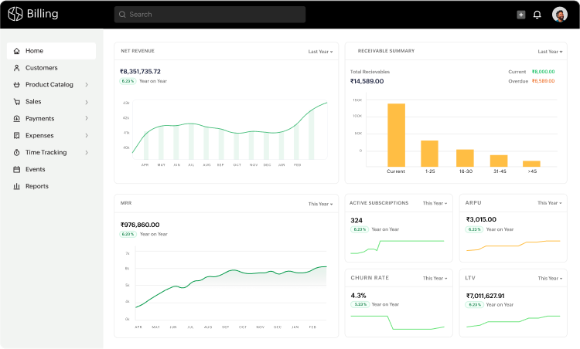



About Bonrix Software Systems
Founded in 2001 with a vision to provide innovative IT solutions
Based in Ahmedabad, Gujarat, India
Leading IT solutions provider in India with cutting-edge technology
Team of talented professionals with expertise in diverse technologies

Slide 3





Our Values & Approach
Unparalleled Customer Support
Long-term Client Relationships
24/7 assistance with dedicated teams for prompt issue resolution
Building partnerships based on trust and mutual growth
Best Development Technologies
Latest Development Methodologies
Utilizing cutting-edge tools and frameworks for robust solutions
Agile and DevOps practices for efficient project delivery
Technology Innovation
Continuously exploring emerging technologies to stay ahead

Slide 4








Our Key Services
GPS Vehicle Tracking
Mobile Recharge
Bulk SMS Software
GST Billing Software
Real-time fleet management with advanced analytics
B2B & B2C recharge solutions
Marketing & communication solutions
Complete accounting & GST compliance
CRM & Autodialer
IoT Monitoring
POS Software
API Banking
Android app for telecallers
Remote dashboard solutions
Point-of-sale & billing solutions
Software integration solutions

Slide 5
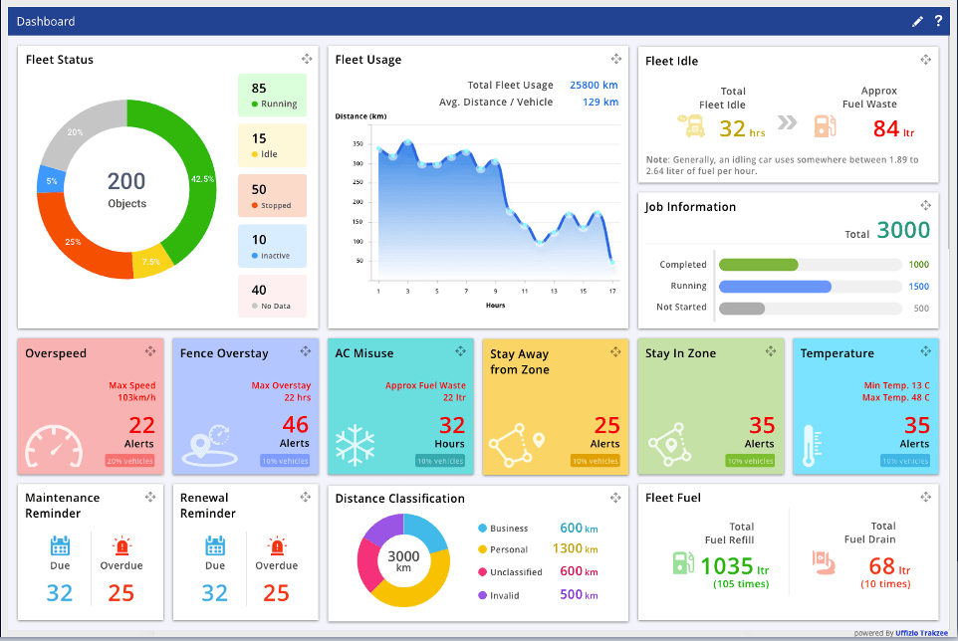





GPS Vehicle Tracking Solutions
Unified Fleet Monitoring
Real-time tracking of all vehicles regardless of fleet size
Multi-Map Precision
Switch between Google Maps, OLA Maps, and MapMyIndia
Multilingual Accessibility
Supports Hindi, Gujarati, Marathi, Bengali, and more
Vehicle Add-On Insights
Monitor fuel levels, engine diagnostics, and maintenance alerts
Advanced Reporting & Analytics
Customizable reports and historical analysis

Slide 6










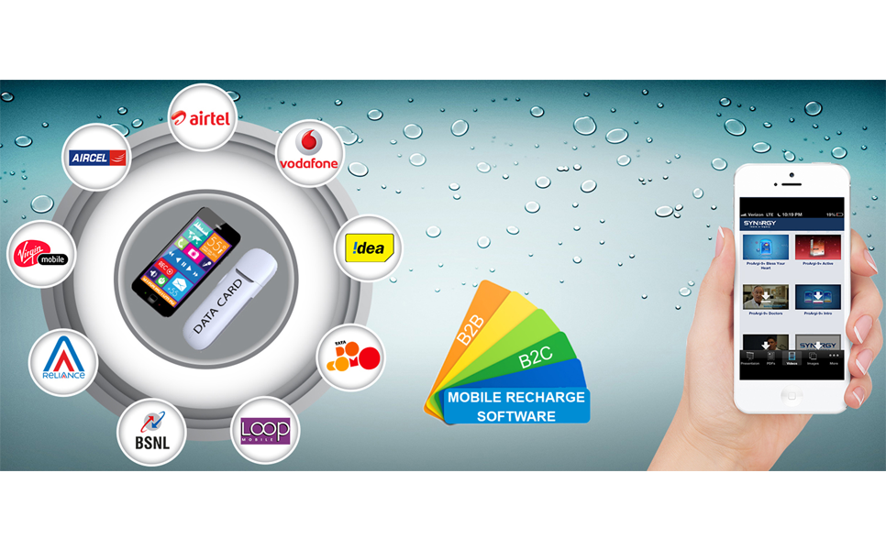
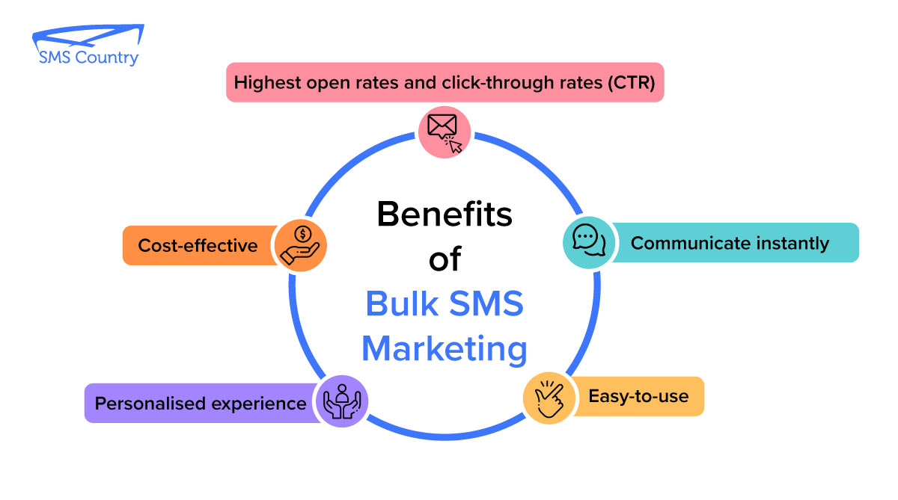
Mobile Recharge & Bulk SMS Solutions
Mobile Recharge
Bulk SMS Software
B2B Mobile Recharge System
Marketing Campaigns
B2C Direct to Retailer System
Transactional Alerts
Multi-operator Support
API Integration
Secure Transaction Processing
Delivery Reports & Analytics

Slide 7









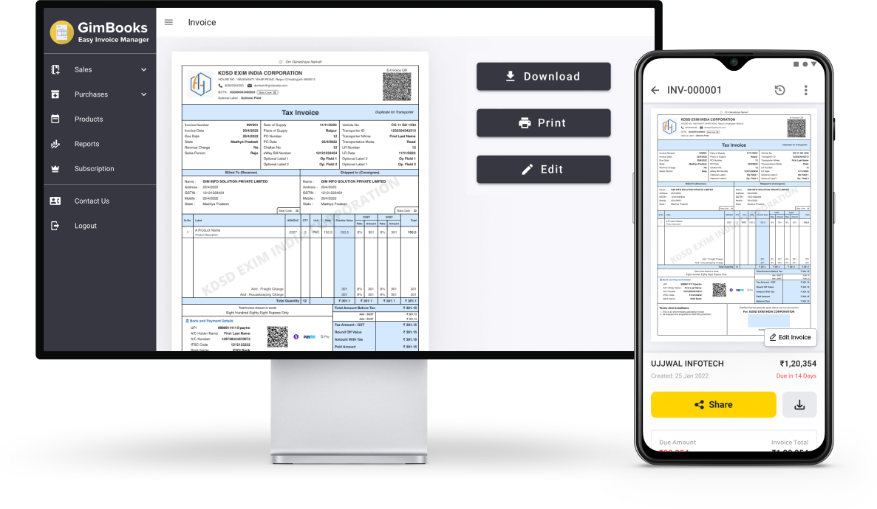


GST Billing & Other Solutions
GST Billing Software
Other Solutions
Customer Management
Expense Tracking
CRM & Autodialer
Inventory Management
GST Reports
Android app for telecallers
Analytics Dashboard
Auto Backup
IoT Monitoring
Remote dashboard solutions
POS Software
Point-of-sale & billing
API Banking
Software integration

Slide 8




Contact Us
Physical Address
A - 801, Samudra Complex, Near Classic Gold Hotel, Off C. G. Road, Ahmedabad, Gujarat, India 380006
Phone
+91-9429045500
Landline: +91-79-26426364
Email
info@bonrix.net
bonrix@gmail.com
Websites

